Slide 1
PERSONNEL DEVELOPMENT PROGRAM DATA COLLECTION SYSTEM (PDPDCS)
CELIA ROSENQUIST, OSEP
SARAH ALLEN, OSEP
MICHELLE BLOOM (ANLAR), PROGRAM COORDINATOR
EMILY HARE (WESTAT), PROGRAM COORDINATOR SUPPORT
December 6, 2023

Slide 2
Purpose of the Training
Orient new grantees to data reporting requirements
Improve the quality of data submitted by grantees
Introduce the Personnel Development Program Data Collection System (PDPDCS)
Notes:
This training was planned with project directors, co-project directors, and other key personnel of Personnel Development Program (referred to as PDP) grants in mind. Specifically, those with new 325D, 325K, 325M, and 325R grants funded in FY 2023.
From the start of your grant award period, we want to –
Orient you to data reporting requirements across the award period of your new PDP grant;
Improve the quality of data submitted to Office of Special Education Program (OSEP) by its grantees;
Introduce you to the Personnel Development Program Data Collection System (PDPDCS); including –
Data submission requirements for grantees, scholars, and employers; and
Resources available to you, your scholars, and their employers

Slide 3
Training Agenda
325D, 325K, 325M, and 325R grant priorities
PDP grantee reporting requirements and performance measures
PDPDCS demonstration
Grantee reporting responsibilities for high quality data
Strategies for avoiding security incidents
Reminders for submitting PDP data
Resources and supports
Notes:
Here is a look at the agenda for today’s training session, we will first go through the grant priorities and grantee reporting requirements and performance measures. There will also be a demonstration of the data collection system, and review information to avoid security incidents, reporting quality data, and resources and supports available to you.

Slide 4
PDPDCS Data Submission Process
OSEP
awards grant
Grantee recruits and selects scholars
Grantee assures that scholars meet regulatory requirements before receiving federal funds
Grantee provides scholarship assistance and grantee/scholar complete Pre-Scholarship Agreement
Grantee submits and updates scholar data
Scholar fulfills obligation through service
Scholar exits program and grantee/scholar complete Exit Certification
Scholar elects cash repayment or is not
in compliance
Scholar submits employment
Scholar referred for cash repayment
Employer verifies employment
4
Notes:
This chart depicts the entire data submission process.
To start, grantees receive a grant from OSEP, followed by the grantees recruiting and selecting scholars to participate in the training program. During the recruitment process, you should meet with scholars, and you are required to provide several important documents to them: (POST IN CHAT)
The 2006 regulations: https://pdp.ed.gov/OSEP/Regulation/ProgramRegs2006
The FAQs: https://pdp.ed.gov/OSEP/Content/pdf/2006faq.pdf and https://pdp.ed.gov/OSEP/Content/pdf/DCS_FAQs.pdf
The Pre-scholarship Agreement and Exit Certification language: https://pdp.ed.gov/OSEP/Home/Agreements/,
The grantee then awards the funds to the scholar and both scholar and grantee complete the Pre-scholarship Agreement (or PSA). Once the PSA is completed and signed, the grantee will enter the scholar’s information into the PDPDCS.
The scholar then begins the training program. After one academic year, the scholar may begin fulfilling the service obligation, but it is not until the scholar has completed OR exited the program that the grace period of 5 years begins. Grantees will need to update the date that the scholar completed one academic year in the PDPDCS.
If a scholar does not complete one academic year of training, that scholar is not eligible to complete a service obligation and will be referred for repayment.
When a scholar either graduates from the program or exits prior to completion, both the grantee and scholar must complete and sign an Exit Certification prior to exiting the scholar from the PDPDCS.
The scholar has the option of fulfilling their obligation through service or through cash repayment. If a scholar chooses to fulfill through service, the scholar will submit eligible employment information in the PDPDCS and the employers verify the information. Scholars who elect cash repayment, or who are not in compliance, are referred for cash repayment to the Accounts Receivable and Bank Management Division (ARBMD).

Slide 5
GRANT PRIORITIES AND REQUIREMENTS
Notes:
The overarching goal of the Personnel Development Program is to increase the number and improve the quality of fully-credentialed personnel, including multilingual personnel and personnel from racially and ethnically diverse backgrounds, who are licensed to serve children with disabilities.
In fiscal year 2023, the Personnel Development Program has funded grants under 4 separate priority grants: 325D, 325K, 325M, and 325R. Each grant follows the same requirements for service obligation and reporting, which we will explain in detail later in this presentation, but there are some differences between the training programs for scholars.

Slide 6

325D FY 2023 Priority
Preparation of Special Education, Early Intervention, and Related Services Leadership Personnel
Doctoral degree program to increased qualified personnel in leadership and research positions
Prepares graduates for:
  Leadership positions as researchers
  Special education/early intervention/
  related services personnel preparers in IHEs
  Leaders in SEAs, LAs, LEAs, or EIS programs
Notes:
We will begin with 325D. The purpose of this priorities is to support doctoral degree programs (Ph.D. or Ed.D) to prepare and increase the number of personnel who are well-qualified for, and can act effectively in, leadership positions as researchers and special education/early intervention/related services personnel preparers in IHEs, or as leaders in SEAs, LAs under Part C of IDEA, LEAs, or EIS programs, Projects must be designed to prepare graduates for leadership positions as researchers personnel preparers in IHEs, or as leaders in SEAs, LAs, LEAs, or EIS programs.
Link: Federal Register :: Applications for New Awards; Personnel Development To Improve Services and Results for Children With Disabilities-Preparation of Special Education, Early Intervention, and Related Services Leadership Personnel

Slide 7
325K, 325R, & 325M FY 2023 Priorities
325K: Preparation of Early Intervention and Special Education Personnel Serving Children with Disabilities who have High-Intensity Needs
325R: Preparation of Related Services Personnel Serving Children with Disabilities who have High-Intensity Needs
325M: Personnel Preparation of Special Education, Early Intervention, and Related Services Personnel at Historically Black Colleges and Universities, Tribally Controlled Colleges and Universities, and other Minority Serving Institutions
Notes:
The 325K, 325R, and 325M grants are intended to fund bachelor's degree, certification, master's degree, or educational specialist degree programs. On this slide the highlighted section of the priority indicates the unique aspect for each funding opportunity.
The 325K grant focuses on preparing early intervention and special education personnel to serve children with disabilities who have high-intensity needs.
Similarly, the 325R grant focuses on preparing related services personnel to serve children with disabilities who have high-intensity needs.
The 325M grant funds personnel attending Historically Black Colleges and Universities, Tribally Controlled Colleges and Universities, and other Minority Serving Institutions to serve all children with disabilities.
325K Link: Federal Register :: Applications for New Awards; Personnel Development To Improve Services and Results for Children With Disabilities-Preparation of Early Intervention and Special Education Personnel Serving Children With Disabilities Who Have High-Intensity Needs
325R Link: Federal Register :: Applications for New Awards; Personnel Development To Improve Services and Results for Children With Disabilities-Preparation of Related Services Personnel Serving Children With Disabilities who Have High-Intensity Needs
325M Link: Federal Register :: Applications for New Awards; Personnel Development To Improve Services and Results for Children With Disabilities-Personnel Preparation of Special Education, Early Intervention, and Related Services Personnel at Historically Black Colleges and Universities, Tribally Controlled Colleges and Universities, and Other Minority Serving Institutions

Slide 8

325K, 325R, & 325M FY 2023 Priorities
Degree programs to increased qualified personnel
  Certificate of completion not eligible
Prepare scholars for professional practice in school settings, distance learning, and natural environments
Notes:
The 325K, 325R, and 325M grants are intended to fund bachelor's degree, certification, master's degree, or educational specialist degree programs. For the purposes of this priority, ‘‘certification’’ refers to programs of study that lead to State licensure, endorsement, or certification that qualifies graduates to teach or provide services to children with disabilities. Programs that lead to a certificate of completion from IHE but do not lead to State licensure, endorsement, or certification, do not qualify.
Each scholar funded under any of these grants should be prepared for professional practice in early childhood programs, classrooms, school settings, distance learning environments, and natural environments (the home and community settings in which children with and without disabilities participate).
325K and 325M programs do allow for dual certification. For example, a 325K project preparing special education personnel may partner with a related services program preparing personnel. In such situations, scholars in the partnering related services degree program may receive scholar support to complete their degree. If you have any questions about the dual certification, please contact your OSEP project officer.

Slide 9

Support for Service Obligation
Consistent with 34 CFR 304.30, each scholar must
  Receive support for no less than one academic year, and
  Be eligible to fulfill service obligation requirements following degree program completion. Funding across degree programs may be applied differently.
Notes:
For each grant type, Project Directors are required to inform scholars about their service obligation commitment and disburse the “scholar support” provided with federal funds.
To meet the requirements, each scholar must: (a) receive “scholar support” for no less than one academic year, and (b) be eligible to fulfill service obligation requirements following degree program completion. This means you need to enroll your scholars with enough time to complete the program.
We have put a link to the service obligation requirements in the chat box. Please review these - You have the responsibility for ensuring scholars understand the service obligation requirements that come with scholar support.

Slide 10

Scholar Funding
Funding does not need to be uniform for all enrolled scholars, but may include:
  Tuition and fees
  IHE student health insurance
  Books, materials, and supplies
  Misc. personal expenses
  Dependent or childcare
  Room and board
  Travel and conference registration
  Stipends to support scholars’ completion
Do not require scholars to work (e.g., as graduate assistants) as a condition of receiving support
Notes:
Scholar support does not need to be uniform for all scholars and should be customized for individual scholars based on scholars’ financial needs, including consideration of all costs associated with the cost of attendance, even if that means enrolling fewer scholars. This slide shows a list of needs that may be covered for OSEP scholars through PDP funding.
Scholar support provided by the project may not be conditioned on the scholar working for the grantee (such as serving as personnel at the university) Scholar should not be required to work in any position not directly related to their training as a condition of receiving support unless the work is specifically related to the acquisition of scholars' competencies or the requirements for completion of their personnel preparation program. In other words, scholars may not work to “pay off” their scholarship to the university.

Slide 11

Scholar Recruitment
Recruit and enroll the proposed number of scholars in the application within the first 12 months of the project
  Focus outreach on traditionally underrepresented applicants
Prior approval from OSEP project officer required before admitting additional scholars beyond proposed number of scholars
Submit a revised project budget if unable to recruit proposed number of scholars
Notes:
As grantees, you should plan to recruit and enroll the proposed number of scholars listed in the application within the first 12 months of your project or demonstrate that those enrolled after the first year will still be able to complete the program by the end of the proposed project period.
You are expected engage in focused outreach and recruitment to increase the number of applicants from groups that are traditionally underrepresented in the field, including applicants with disabilities, multilingual applicants, and applicants from racial and ethnic diversity backgrounds, but the selection criteria must ensure equal access and treatment of all applicants seeking admission to the program and must be consistent with applicable law, including Federal civil rights law.
If you intend to enroll greater than the number of scholars proposed in the application, you must obtain approval from your OSEP project officer. This includes if you are looking to transfer a scholar to another OSEP-funded grant.
You must submit a revised project budget to OSEP if you are not able to recruit and enroll the originally proposed number of scholars that can graduate from the program by the end of the project period.
The Secretary may reduce continuation awards for any project in which scholar recruitment is not on track or scholars are not on track to complete the program within the project period.

Slide 12
GRANTEE REPORTING AND EVALUATION
Notes:
As a condition of receiving OSEP support, grantees are required to report annually on their performance. For those with PDP grants, that includes annual reporting on grant project activities and use of federal funds in the APR AND submitting electronic data each funded scholar annually in the PDPDCS. Grantees must comply with reporting requirements in order to be considered for continuation funding.
The primary purposes of the data collection are to track the service obligation fulfillment of scholars who receive funds from OSEP grants and to collect data for program performance measure reporting. Program performance measure reporting allows OSEP to monitor PDP’s performance toward meeting its targets and to demonstrate the overall effectiveness of the grant program over time.

Slide 13
PDP Performance Measures Purpose
Helps measure whether the PDP is
meeting its objectives
Demonstrates PROGRAM progress
and effectiveness over time
Used by Congress to determine future
program funding
Required under the Government Performance and Results Act (GPRA)
Notes:
The Office of Management and Budget (OMB) established the Government Performance and Reporting Act (GPRA) as an accountability system for all discretionary grant programs across the federal government. The Personnel Development Program developed program performance measures which allow OSEP to measure and report the extent to which the PDP is meeting its goals outlined in IDEA for the appropriated funds.
Data that OSEP reports for the Personnel Development Program comes from several sources, but predominantly from grantees, scholars, and employers reporting in the PDPDCS. Results are aggregated across grant projects and reported annually to the Department, the Office of Management and Budget (OMB), and Congress. This data is also included in the Department’s budget request which may be used by Congress to determine future funding for this program.
As a result, grantee reporting is both a critical step in determining continuation funding for your grant project and affects future funding for the Personnel Development Program as a whole. We want to ensure you have a shared understanding of your reporting requirements from the start of your grant as one means to benefit your project and to ensure accountability for the PDP.
Your grant must report on two types of measures, GPRA performance measures – also known as PROGRAM measures - (required of all grants funded under CFDA 84.325) and PROJECT performance measures (which are unique to your project). This section will focus on PROGRAM (or GPRA) performance measures; those measures that all grantees must report on with a PROJECT-level performance measure that is aligned.

Slide 14

PDP Government Performance and Results Act (GPRA) Measures
Sources of Data:
  Grantee enters data in PDPDCS for each scholar receiving support on grant at -
    Enrollment,
    Annually during enrollment, and
    Exit (e.g., complete degree program)
  Scholar enters employment information
  Employer(s) verify employment
Notes:
FOR PDP, the sources of data used to report on GPRA or PROGRAM performance measures comes primarily from information that grantees, scholars, and employers enter into the PDPDCS for each scholar.
To fulfill PROGRAM performance reporting, grantees need to report on each scholar at the following times --
Enrollment (when a scholar enrolls in the degree program and accepts “scholar support”). Grantees must submit the signed Pre-Scholarship Agreement and information about the scholar, including contact information, demographic information, and training program information such as degree sought, length of the program, and special education areas covered.
Annually; that is, you review and update scholar data annually during the Annual Data Collection period, and when they
Exit the program. Finally, you report when each scholar “exits” the project. When an OSEP Scholar is no longer receiving “scholar support” you need to report to PDPDCS and specify why. Is the scholar “exiting” because they completed the degree program and is graduating? Did the scholar “exit” without completing the program due to personal reasons, a transfer, or the grant is ending?
Each scholar who is entered into PDPDCS, ultimately must be “exited”. If your scholars are still enrolled at the time your grant ends, you still MUST exit your scholars and note that they exited without completion due to grant ending.
Additionally, scholars submit their employment information. After completing one academic year of training with “scholar support,” scholars may enter employment in PDPDCS.
Finally, employers must verify employment of scholars. Employment data are (a) required for fulfilling service obligation, and (b) used collected, and analyzed, to fulfill the PDP PROGRAM performance measure reporting requirements.

Slide 15

PDP PROGRAM Performance Measure 1
The percentage of preparation programs that incorporate evidence-based practices into their curricula.
Source of data: Expert panel review of syllabi from PDP grantees conducted one year following the grant award.
  Syllabi from FY 2022 grants will be
  reviewed & results reported in FY 2023
  Syllabi submitted in application AND new or revised syllabi submitted to OSEP will be used
  More information will follow in Year 1
Notes:
A list of all the PDP PROGRAM performance measures are available on the PDPDCS. Link: https://pdp.ed.gov/OSEP/Home/performancemeasures
Here, on this slide, you will see PROGRAM Performance Measure 1 along with the data source we use to report on this PROGRAM performance measure. Specifically, Measure 1 is the percentage of preparation programs that incorporate scientific or evidence-based practices into their curricula.
For Measure 1, the data source is the syllabi that were provided in your applications along with any new or updated syllabi that you submit to OSEP in Year 1 of your project. An expert panel will review the syllabi for the FY 2023 grants during the 2024 reporting period. If you have developed syllabi for new courses during a program planning year or updated syllabi in Year 1, you may submit those syllabi to your project officer.

Slide 16

PDP PROGRAM Performance Measure 2
The percentage of scholars completing preparation programs who are knowledgeable and skilled in evidence-based practices for children with disabilities.
Source of Data: Grantees enter data into the PDPDCS regarding scholar’s exit/completion status and their chosen measure.
  Grantees must include at least one
  measure to demonstrate each scholar
  is “knowledgeable and skilled in use
  of EBPs” for children with disabilities.
Notes:
Measure 2 examines the percentage of scholars completing OSEP-funded preparation programs who are knowledgeable and skilled in evidence-based practices for children, including infants and toddlers, with disabilities.
OSEP expects that all grants will have identified at least one measure demonstrating knowledge of and skills in using EBPs for all scholars who complete each degree program.
We recommend that you conduct an exit interview with each scholar as they prepare to exit their degree program. During that interview you will want to collect any additional data you need to complete the scholar’s record in the PDPDCS; including results on any test(s) of knowledge or skills that scholars have completed.
I am going to share with you examples of acceptable measures and unacceptable measures in the next slide.

Slide 17
PDP GPRA Performance Measure 2 - continued
Examples of Measures of Knowledge and Skills
ACCEPTABLE Measures | UNACCEPTABLE Measures
Grantee-specific tests (e.g., portfolio, comprehensive exam, dissertation defense) PRAXIS II National organization tests State-specific tests Capstone project or exam required of scholars prior to degree program or grant project completion | Entrance exams (e.g., PRAXIS I, GRE, SAT) University preliminary exams Individual course exams or grades
Notes:
Here are examples of acceptable measures and unacceptable measures that would demonstrate that a scholar is knowledgeable and skilled in use of EBPs. These options will also be shown within the scholar record once you indicate that a scholar has completed or graduated.
You will need to know whether scholars have completed and passed each measure. If necessary, establish it as an expectation that they report the results to you; perhaps include a copy of the results in their official file.

Slide 18
PDP PROGRAM Performance Measure 3
The percentage of scholars who exit preparation program prior to completion due to poor academic performance.
Source of data: Grantees report scholar’s exit/completion status and
reason for exiting prior to
completion, if applicable.
Notes:
Measure 3 is the percentage of scholars who exit preparation programs prior to completion due to poor academic performance.
I would like to add that OSEP has been very pleased with grantee performance on this measure. Consistently we have reported less than 2 percent of scholars exit due to poor academic performance.

Slide 19
PDP PROGRAM Performance Measure 4
The percentage of scholars completing preparation programs who are working in the area(s) for which they were prepared upon program completion.
Sources of data:
  Grantees report scholar’s training area and exit/completion status.
  Scholars and employers report
  scholar’s employment area after
  exit.
Notes:
Measure 4 examines the percentage of scholars (those graduate students who received “scholar support” from the OSEP-funded grant) completing the preparation program (that is the degree program and grant project requirements) who are working in the area(s) in which they were prepared upon program completion.
Scholars will submit their employment data, which is verified or disputed by the employer. During this process, the scholar and employer agree upon the area or areas in which the scholar is working. The scholar selects a special education area, similarly to the list of areas that the grantee chooses to describe the training program.
Our goal is for you to have as many (or more) program completers as specified in your grant application. OSEP and the Department monitor those numbers quarterly and expects grantees to meet that obligation.

Slide 20

PDP PROGRAM Performance Measure 5
The Federal cost per scholar who completed the preparation program.
Sources of data:
  ED G5 database provides financial data for each grant; and
  Grantees report in G5 scholars funded under 84.325 grants who exited the training program through completion.
Notes:
Measure 5 examines the Federal cost per scholar who completed the preparation (degree) program.
The data for Measure 5 are retrieved by OSEP using –
1. The Department’s G5 database that houses financial data for each grant; and
2. G5 data reported by the grantees on the total amount of “scholar support” provided.

Slide 21
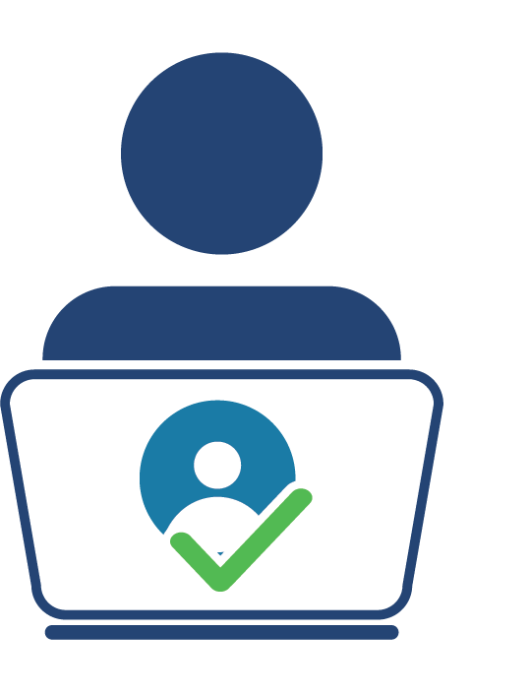
PDP PROGRAM Performance Measure 6
The percentage of scholars who completed the preparation program and are employed in high-need districts.
Source of data:
  Scholars who have completed the preparation program and their employers have
  verified their employment.
  CCD and School Universe surveys
  determine if a district is labeled as
  high-need.
Notes:
Measure 6 is the percentage of scholars who completed the preparation program and are employed in high-need districts. OSEP and PDP have defined “high-need districts” in the NIA to include high-poverty LEAs, implementing a comprehensive support and improvement plan, or implementing a targeted support and improvement plan.
The source of data for Measure 6 are retrieved by OSEP by using:
Information the scholar submits about their employment; the employer reviews and verifies the scholar’s employment information.
For scholars who have verified employment only - The Common Core of Data (CCD), Local Education Agency (School District) Universe Survey and Public Elementary/Secondary School Universe Survey, is the second data source for this measure. Districts where the scholars are employed are matched to districts in the CCD to determine if a district is high-need district.
Please note that this measure does not apply to 325D grantees with a focus on preparing faculty.

Slide 22

PDP PROGRAM Performance Measure 7
The percentage of scholars who completed the preparation program and are rated effective by their employers.
Source of data:
  Scholars who have completed
  their program and choose to
  submit their employment
  information; and
  Employers rate the scholar’s effectiveness during the verification process.
Notes:
Measure 7 examines the effectiveness of scholars who completed the preparation program using 5-point Likert-type rating scale completed by employers.
The data for Measure 7 are retrieved by OSEP using –
Scholar’s employment data, and
During the employment verification process within the PDPDCS, one of the questions requires employers to rate the scholar’s level of effectiveness in their position.

Slide 23

PDP PROGRAM Pilot Outcome Measure
The percentage of scholars who completed the preparation program and are employed in the field of special education for at least two years.
Source of data:
  Grantees report scholar’s exit/completion
  status.
  Scholars and employers report
  scholar’s employment area after
  exit.
Notes:
In addition to the approved PROGRAM performance measures already discussed, PDP has worked with OMB to outline an OUTCOME measure for PDP. Our team is collecting baseline data to determine if this is an adequate PROGRAM performance measure to institute in the future.
As with other PROGRAM performance measures, OSEP collects the data needed to report on this OUTCOME MEASURE. For this specific measure, data are retrieved by OSEP using –
PDPDCS data on scholars’ program completion status reported by grantees, and
Employment data reported by scholars and verified by their employers
Please note that there are two other project-specific measures from last year’s NIA. Those other project measures will be reported by grantees on in their Annual Performance Reports (also called APRs), which will be discussed in the next slide.

Slide 24
Grant Performance Reports: APR
Annual Performance Reports (APR)
OSEP will send instructions for preparing and submitting APRs to grantees prior to February 1 annually
APR Resources (https://osepideasthatwork.org/resources-grantees/program-areas/personnel-development-improve-services-and-results-children?tab=pa-measurement)
Deadline for submitting is COB on the first Friday in May (4:30 pm ET)
Submitted in G5 (http://www.g5.gov)
Notes:
In addition to reporting scholar data using the PDPDCS, PDP grantees are required to submit PROJECT data on individual projects. Grantees must complete and submit an Annual Performance Report (aka “APR”) in G5 no later than the first Friday in May.
In general, the APR will ask for information on (a) your progress implementing the project outlined in the grant project funded; including activities you proposed to completed to meet goals and objects outlined for your grant application, scholar performance related to the PROGRAM performance measures, and so forth; and (b) management of federal and non-federal funds.
Each year, OSEP, on behalf of the Department, will email Project Directors and Authorized Users the instructions on preparing and submitting APRs prior to February 1. The instructions come in the form of a Dear Colleague Letter from Larry Wexler, the RTP Division Director.
These APRs will be used to make decisions about continuation funding for Year 2 of your grant award considering the factors that I just mentioned.
The link to the APR resources includes several recorded trainings as well as other supports to assist you with this effort. Your project officer will have information to share and is a good resource if you have any questions. Many grantees submit a draft APR to their project officer in mid- to late March, so the PO has an opportunity to review and provide feedback prior to the submission deadline. I encourage you to take advantage of that opportunity for review and feedback; most grantees report that they find it helpful.
OSEP requires that a performance report is on file every 12 months, including during time you might have a no cost extension.
APR Resources link (for chat): https://osepideasthatwork.org/resources-grantees/program-areas/personnel-development-improve-services-and-results-children?tab=pa-measurement

Slide 25
Grant Performance Reports: FPR
      Final Performance Report
      OSEP instructions will clarify which portions require updates, summaries of the full award period, and/or new information
      Due no later than 90 days after end of project award period
      Submitted in G5
Notes:
A Final Performance Report is due no later than 90 days following the end of your award period. The Final Performance Report has similar, but not the same requirements as the APR. Carefully review the Instructions to clarify which portions of the report requires only an update from the time of your last APR, which requires reporting for the full grant award period (5 years), and which asks for new information.
I would like to encourage you to keep these timelines in mind and begin now to establish the practices needed to fulfill reporting requirements.
Scholar accomplishments ( e.g., public service, awards, publications) will be reported in annual and final performance reports

Slide 26
FY 2023 Grants Project Evaluation
Collect, analyze, and use data on scholars on an ongoing basis
Provide feedback and permit periodic assessment of progress toward achieving intended outcomes
Continually evaluate the goals or objectives of the project
Notes:
Lastly, all PDP grantees must continually evaluate their projects. This data will go into the PDPDCS as well as in your APR and FPR. You should collect, analyze, and use data on scholars supported by the project on an ongoing basis to evaluate how well the goals or objectives of the project have been met. This includes the outcomes to be measured for both the project and the scholars, particularly the acquisition of scholars' competencies. Grantee evaluations should provide performance feedback and permit periodic assessment of progress toward achieving these intended outcomes.
In your application, you should have described the outcomes to be measured as well as the methodologies.
Again, evaluation results will be reported to OSEP in the annual and final performance reports.

Slide 27
USING THE PDPDCS

Slide 28
PDPDCS: Live Demonstration
PDPDCS demonstration will show:
  Logging into the system
  Updating grant and contact information
  Adding a secondary user
  Using the digital Pre-Scholarship Agreement (PSA) or uploading a physical PSA and entering scholar data
  Updating scholar data
  Tracking scholar’s service obligation fulfillment
  Using the digital or physical Exit Agreement (EC) to exit a scholar
Notes:
For the live demonstration, please watch the webinar recording at https://youtu.be/9t3q1xzmGPA

Slide 29
PDPDCS Setup Reminders: Secondary Users
Project Directors are responsible for all data entries; however, secondary users are permitted to assist in the process.
Secondary users:
  Can enter scholar information, and
  Have a unique log in.
Only three people per grant may access.
  Project Directors may change the secondary user(s) at any time.
Note: You may NOT create a shared inbox for your secondary user(s) – each user requires a unique login.
Notes:
PDPDCS recently allowed Project Directors to include an additional secondary user to their grant, for a total of 3 users per grant.
Secondary users can enter scholar information, reducing the Project Director’s data entry burden.
Adding secondary users have a unique log in, eliminating the need to share passwords and improving data security.

Slide 30
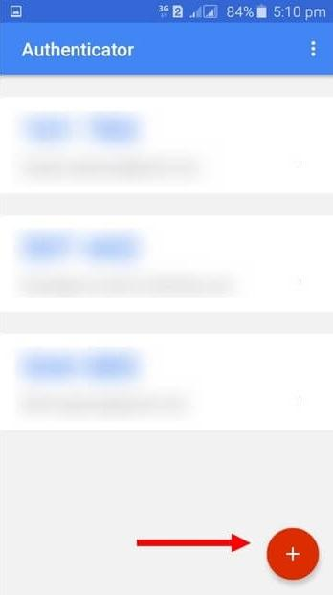
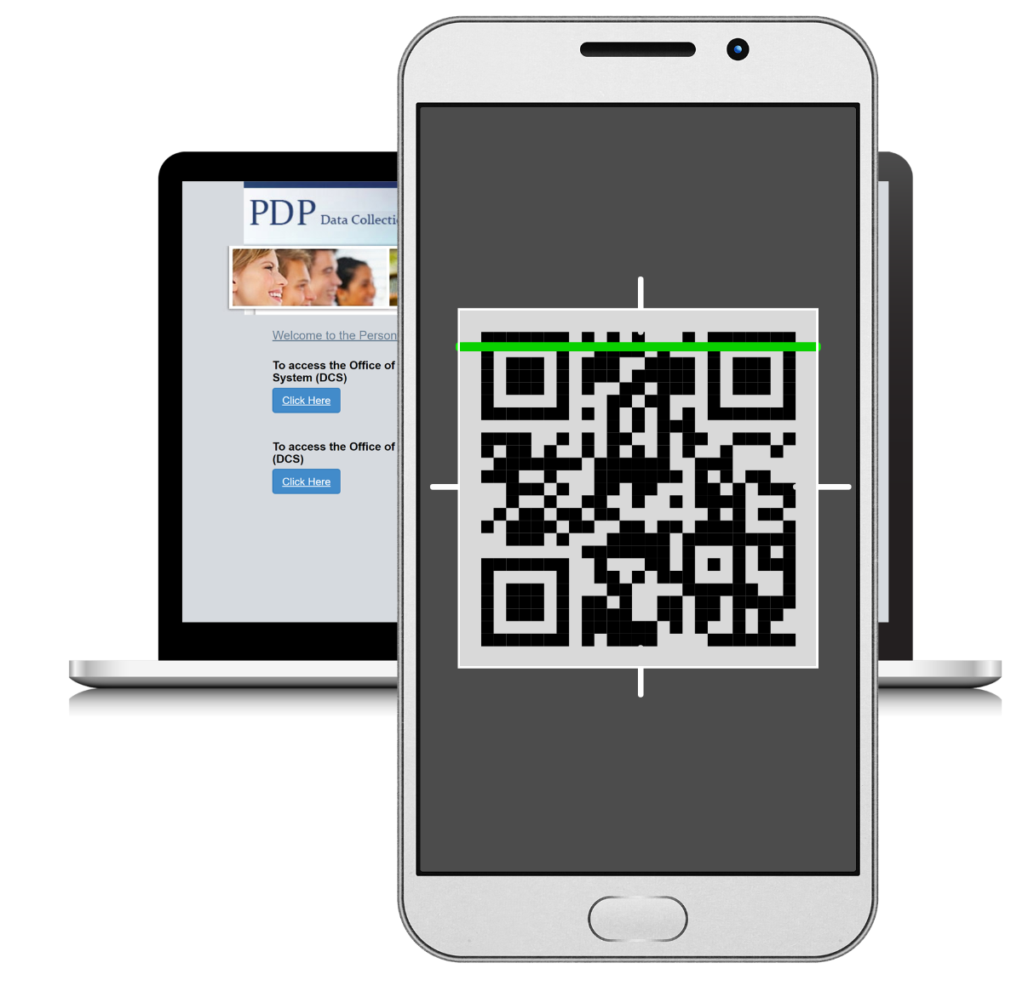
Enrolling in MFA for the PDPDCS
Download and install Google Authenticator on your smartphone
  The app is available through the Apple App Store or
  Google Play Store by searching for “Google Authenticator.”
Pair the app and PDPDCS
Open the Google Authenticator
app
Click the + button on the app to
add the PDPDCS website
Scan the QR Code from the
PDPDCS website enroll page
with your smartphone by holding
the camera up to the website
Notes:
Multifactor Authentication or MFA, required by the PDPDCS, is a security process where a user verifies their identity in multiple ways to gain system access.

Slide 31

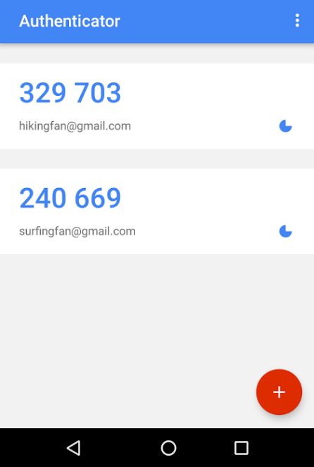
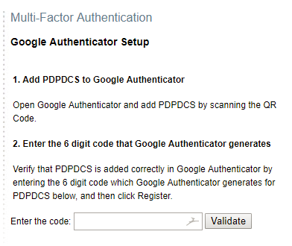
Enrolling in MFA for the PDPDCS - continued
Enter code in the app
Enter the code generated by the Google Authenticator app into the PDPDCS enroll page and click “Validate.”
Remember to enter the code quickly as each code is only valid for 30 seconds. As soon as another code is generated, the preceding one becomes invalid.
6-digit code
Enter code here

Slide 32
Signing into the PDPDCS in the Future
Each time you sign into the PDPDCS from any device you will need to complete these steps:
Enter your username and password in the PDPDCS.
Open the Google Authenticator app on your smartphone and enter the 6-digit security code* into the PDPDCS when prompted by the system.
Note:
If you create a new password, you will need to scan the QR code on your smartphone again.
If you purchase a new device, please contact the Help Desk to reset your MFA so you can scan the QR code and add it to your phone again.
*Remember: Each code is only valid for 30 seconds
Notes:
Each time you sign into the PDPDCS, you will need to complete the MFA. To do this, follow steps 1 and 2.
As a reminder, the PDPDCS will automatically sign any user out after 30 minutes of inactivity. If you get signed out, you will need to complete the MFA to sign in again.
Additional MFA resources can be found on the training webpage under the Multifactor Authentication header: https://pdp.ed.gov/OSEP/Home/Training

Slide 33
PDPDCS SUBMISSION REQUIREMENTS

Slide 34
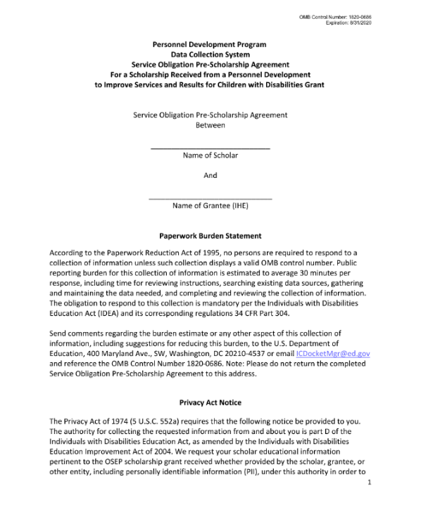
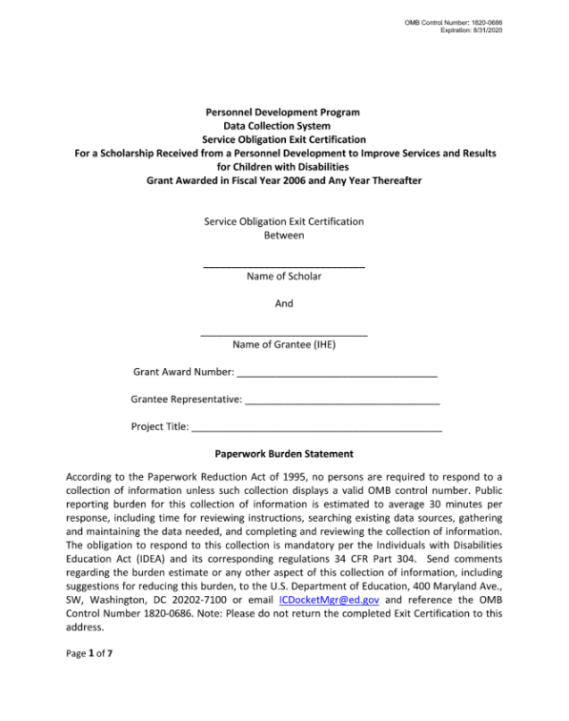
PDPDCS Forms
Grantees and scholars must sign an OMB-approved Pre-Scholarship Agreement and Exit Certification for each funded scholar.
Grantees may be held responsible for funds provided to scholars with missing or invalid documents.
Grantees must retain all grant
records until each scholar’s
service obligation has been
fulfilled or paid back.
Notes:
The legally binding PSA outlines the terms and conditions of PDP funding; grantees are responsible for the accuracy and maintenance of these documents for funded scholars. If you choose to use the digital version of the PSA, please make sure you download and save a completed copy.
Grantees must retain grant records until all service obligation has been fulfilled or paid back. So please try to stay in touch with scholars until they have completed their service obligation.

Slide 35

Timeline for Enrolling Scholars
Enter and submit scholar contact and enrollment information within 30 days of scholar enrollment in degree program.
The scholar must have:
  Registered for classes
  Received “scholar support” from
  grant project
  Signed PSA
Notes:
GRANTEES must enter and submit scholar information into the PDPDCS within 30 days of a scholar “enrollment” in the program. That is, within 30 days of the scholar -
Registering for classes,
Receiving funding from the PDP grant project, and
And signing the Pre-Scholarship Agreement, which can be done digitally. Once the PSA is finalized, grantees will still need to finish creating and submitting the scholar record.
Typically, this occurs within 30 days of the start of the first semester. It would not be prior to classes beginning.
Although the system is available year-round, by the Spring of each year (during the data collection period), grantees are required to have all scholar data up-to-date for all scholars who were enrolled during the previous fiscal year. We recommend logging into the system to make these updates at least every 6 months.

Slide 36
Pending Scholars
OSEP requires that scholars are in a pending status for no more than 30 days.
Help Desk staff will contact you and your Project Officer if your grant has scholars in a pending status at the end of each annual data collection period.
Notes:
Scholars whose information has been entered and “saved for later” will be in a pending status. Scholar records must be “submitted” to ensure their information is complete and can be captured for reporting on the PDP PROGRAM performance measures. Clicking “save and submit” on each scholar record will prompt the system to send an email to the scholar welcoming them to the PDPDCS, which includes log-in information, and allow the scholar to access their record within the PDPDCS. Scholar records must also be submitted for scholars to begin entering eligible employment, if applicable.
Scholars cannot remain in a “pending” status for longer than 30 days and scholar records cannot be “submitted” until all required items are entered.
PDPDCS Help Desk will identify grantees who fail to “submit” timely, accurate, and complete scholar data and will take appropriate actions, including referring to OSEP any noncompliant grantees. Your project officer will then contact you to discuss why you have not submitted scholar data.

Slide 37
Timeline for Updating and Exiting Scholars
Update scholar contact and program completion information within 30 days of:
  Scholar status changes
    Enrolled but no longer funded
    Exited Prior to Completion
    Graduated
  Grant budget period ending
  Note: Scholars are not fully considered exited until the EC has been signed AND the scholar’s record has been submitted.
Notes:
Timeline for updating and exiting scholars – note that “exiting” here refers to either graduating or exiting prior to completing the program.
Grantees’ must update scholars’ information within 30 days of a change in a scholar’s status. For example, a grantee will need to change the scholar’s status in the PDPDCS within 30 days of that scholar graduating or exiting prior to completing the program.
When exiting a scholar using the digital Exit Certification, there are two steps to keep in mind. Grantees must first fill out the agreement and ensure it is signed and finalized by the PD and scholar. THEN the grantee can officially exit the scholar by completing the rest of the scholar record in the PDPDCS and submitting it.
The burden falls on the grantee to follow-up with the scholar and ensure the agreements are signed within the required 30-day timeframe prior to official exit from the training program.
Lastly, by the time your grant budget project ends (5 years), you must “exit” all scholars before submitting the Final Performance Report.

Slide 38

Scholar Submission Requirements
Once a scholar record is submitted by the grantee, scholars will access the PDPDCS to:
  Confirm contact information;
  Review training information;
  View service obligation status; and
  Enter eligible employment information to fulfill their service obligation.
Notes:
After scholars have completed one academic year of their preparation (or training) program, they are eligible to begin entering employment toward fulfilling their service obligation. Scholars may begin receiving credit for employment while they are enrolled as long as they have completed the academic year.
It is very important to you, as grantees, to update the PDPDCS with the date that scholars have completed one year of academic training with scholar support so that the scholars may begin entering their employment. Once that date is entered, it will activate the link on the scholar side that allows scholars to begin entering employment.
Please ensure your scholars log on to the PDPDCS at least once every year to review information and become familiar with the process using PDPDCS, even when they are still enrolled. ALSO teach them to login every year to verify employment after graduating.

Slide 39
Service Obligation Requirements
Requirements for employment to be deemed eligible:
  Paid position, not funded by an OSEP grant program
  Cannot be part of an internship, practicum, or other work-related requirement of the scholar’s completion of the preparation program
Notes:
FAQs for service obligation: https://pdp.ed.gov/OSEP/Home/faq2006#6

Slide 40
Service Obligation Requirements – continued
Direct Service:
At least 51% of the infants, toddlers, and children to whom the individual provides services are receiving special education, related services, or early intervention services from the individual; or
The individual spends at least 51% of their time providing special education, related services, or early intervention services to infants, toddlers, and children with disabilities.
Indirect Service:
If the position involves supervision including in the capacity of a principal, teaching at the postsecondary level, research, policy, technical assistance, program development, or administration, the individual spends at least 51% of their time performing work related to the scholarship training.
Notes:
If serving children, the children served must fall under the definition of eligible children as described in section 602(3) of IDEA (see IDEA section 602(3), https://pdp.ed.gov/OSEP/Regulation/ProgramRegsIDEA602#childdisability for the IDEA definition).
Under section 662 of the Act available on the PDPDCS website at: https://pdp.ed.gov/OSEP/Regulation/ProgramRegsIDEA662.

Slide 41

Scholars’ Employment Record
Information collected includes:
  Contact information;
  Type of organization;
  Dates of employment;
  Type of employment;
  Full or part time position;
  Training area(s);
  Whether the position meets PDPDCS time requirements; and
  Certification or licensure.
Notes:
Scholars are responsible for entering their employment information, but grantees can answer questions or assist if needed. Grantees cannot access scholar employment records. Scholars can always be directed to contact the Help Desk with any questions.
Both legal and ethical issues are associated with service obligation, and we encourage you to talk with scholars about the importance you place on fulfilling this professional obligation from both perspectives.

Slide 42
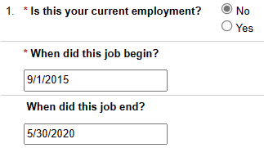
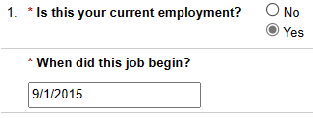
Service Obligation Calculator
Previous Employment
Current Employment
Notes:
We receive a lot of questions about the service obligation calculator. On this slide you can see the first question of the scholar employment record, which asks if the position is the scholar’s current employment. If the scholar indicates no, then they will be able to enter an end date for the job.
Scholars cannot receive credit for employment until their employer verifies that the scholar was employed for the indicated time period. Only previously completed employment can be verified. If the scholar is submitting a record for their current employment, the “end date” of their employment will be the date that the record was submitted (so if it were submitted today, the end date registered in the system would be December 6th, 2023).
Please remind your scholars to update their employment every 6 months to display an accurate service obligation status on the PDPDCS.

Slide 43
Employer Submission Requirements
Employers verify employment
information within the PDPDCS
  Scholars do not receive credit for service obligation until the employer has verified their employment
  Scholars receive an email when their employment is verified or disputed
Notes:
The scholars’ EMPLOYERS are the final group to enter the PDPDCS. They will review and verify the employment information submitted by the scholars.
Scholars do not receive credit toward fulfilling their service obligation until their employer verifies their employment. NOTE - Scholars are responsible for obtaining their employer’s verification. Please be sure to advise scholars on this requirement! They will receive an email when their employment has been verified or disputed.
We recommend that scholar’s reach out to their employer before submitting an employment record to alert them that a verification email will be coming from serviceobligation@ed.gov.

Slide 44
AVOIDING SECURITY INCIDENTS

Slide 45

Security Incidents
A security incident occurs if personally identifiable information (PII) is potentially viewable to unrelated parties.
Examples from PDPDCS:
  Uploading an unredacted Pre-Scholarship Agreement (PSA) PDF to the wrong scholar record
  Sending unencrypted documents
  (Social Security Card, Driver’s
  License, etc.) in an email to the
  PDPDCS Help Desk
Notes:
Scholar agreements and records within the PDPDCS contain significant amounts of scholar’s personally identifiable information (PII).
It is the responsibility of the grantees to protect this scholar information. Improperly handling PDP documentation could expose a scholar to potential identity theft and impact the university’s ability to receive future funding from the Department.
We recommend using the digital PSA feature to avoid potentially uploading an unredacted document to the wrong scholar record.

Slide 46
Impacts of Security Incidents on Department Staff
PDPDCS staff must notify the Department’s Education Security Operation Center (EDSOC), document the incident, and expunge the file or email from the servers
Additional interviews, investigations, and mitigation strategies may be necessary
PDPDCS Staff must review all other scholar records and documentation associated with the grantee
Notes:
Every security incident that occurs requires significant resources from the Department to mitigate the impact. These steps require hours of paperwork and Department resources to address. Further, we all want to do our part to protect PII of scholars.

Slide 47
Impacts of Security Incidents on Grantees
Grantees must resubmit scholar documentation, complete security incident report, and participate in investigation interviews as needed
Project Directors and Secondary Users will be required to participate in a security training to understand the proper handling of scholar PII and the consequences of data breaches
The grant will be placed on a security incident list tracked by PDPDCS and OSEP staff. If further incidents occur, the grant and university could be placed on high-risk status, impacting their ability to receive future federal funding
Notes:
In addition to the potential effects of sharing PII, grantees may also encounter these consequences as result of one or multiple security incidents.

Slide 48
Avoiding Security Incidents
Always encrypt files being sent by email, including to the PDPDCS Help Desk.
Use the digital Pre-Scholarship Agreements and Exit Certifications to avoid uploading a document to the wrong scholar record.
Implement a file naming convention to track files associated with each scholar’s record: PSA_J_DOE.pdf.
Notes:
More information on avoiding security incidents and how to encrypt files is available on the PDPDCS training webpage under System Security.

Slide 49
HELPFUL PDPDCS REMINDERS

Slide 50

Always Read System Emails
Notifications regarding system
or policy changes as well as
data submission reminders
are sent via email.
  Please add serviceobligation@ed.gov to your contact list.
  Check your email settings to be sure emails from this account are not marked as spam.
Notes:
PDPDCS will communicate with grantees, scholars, and employers by email so make sure you have serviceobligation@ed.gov on your contact list. Remind your scholars to add serviceobligation@ed.gov to their contact lists as well.
Copies to project officers and the grant’s Authorized or Certifying Representative are included on some email notifications.

Slide 51
Scholar Contact Information
OSEP and PDPDCS staff must be able to reach scholars after they graduate or leave your IHE. Please enter a non-IHE email address for each scholar.
Personal email (e.g., Gmail, Yahoo, Outlook)
Work email
If the scholar has multiple emails, include a second non-IHE email in the alternative email field.
Notes:
Because scholars will need to login to the PDPDCS for several years after they finish the training program, please use a personal email address for your scholars instead of their school email address. If the scholar has multiple emails, please include a second email address in the alternate email field so our Help Desk and support team can verify the scholar should the need arise.
We highly recommend that you ask scholars to log in to PDPDCS each year while they are still enrolled in the degree program and receiving scholar support, so they become familiar with the system while still with you.

Slide 52
PDPDCS Reporting:
Timely Submission
Submit all data on time (APR, PDPDCS, and FPR).
  According to 34 CFR 75.253(a)(3), the timely submission of this report is one of the factors that the Secretary will consider in determining whether to continue your project's funding for next fiscal year.
  According to section 75.217(d)(3)(ii), the Secretary can consider the failure to submit scholar data in a timely fashion in determining your project’s ability to obtain future grants from the Office of Special Education Programs or under any other Department program.
Notes:
[As an OSEP grantee, you are required to submit data for continuation funding and other reporting, such as performance measures and service obligation.
Failure to submit data or submit data on time can be considered in determining your ability to obtain future grants not only from OSEP by from other Department programs.

Slide 53
Managing PDPDCS Grants and Timelines
Project Directors must manage grants to ensure that:
All scholars can complete the degree program before the grant ends;
Scholars are enrolled early (Year 1) with sufficient time, funding, and support to complete the program; and
The number of scholars proposed, enrolled, and completed meets outlined expectations.
Contact your OSEP Project Officer to discuss changes in the number of or completion status of scholars.
Notes:
It is up to the grantee to ensure that scholars are enrolled with enough time, funding, and support to complete the training program within the grant project period. Please make sure you are making these timing considerations when recruiting.
You need to manage the grant so that all scholars complete the program before the grant ends. A Department priority over the past several years is for projects to end within the established grant project period. OSEP may consider grantees request for a one-time, no cost extension to allow more time –up to 12 months, no new money– for scholars to complete the preparation program and graduate. We want scholars to “complete” the program and be counted as program completers!
A second no-cost extension is unlikely to be approved. Once again, it is important that scholars are recruited and can complete their training program by the end of the grant project period.

Slide 54
Exit All Scholars BEFORE Your Grant Ends
Any scholar who has not graduated/completed or previously exited when a grant closes will be assigned the status of “exited without completion”
  Project Directors are responsible for obtaining Exit Certifications from these scholars too. Service obligation requirements still apply.
Reason for “exited without completion” status is required:
  Poor academic performance
  Transferred to another training program
  Grant ending prior to preparation program completion
Notes:
When OSEP funding ends, at the conclusion of a grant, it is the responsibility of the grantee to “exit” all scholars in PDPDCS.
ALL scholars MUST sign an Exit Certification upon exiting the program. A scholar that will still be enrolled in the program after funding ends should still be exited from PDPDCS.
If the “exited without completion” status is selected for a scholar, you will be prompted to enter the reasoning. There are a few of the many potential options shown on the slide, but if your grant has ended, please select that option.
If scholars are still enrolled at the time the grant ends, PDPDCS staff will contact you and your OSEP Project Officer to resolve scholar records.

Slide 55
Scholar Reporting Requirements
Recommend to your scholars to review the resources available on the Training Page: https://pdp.ed.gov/OSEP/Home/Training
Notify scholars at the beginning of the program that they will be required to provide licensure test results to you.
Arrange and conduct exit interviews with each exiting scholar.
Notes:
As mentioned at the beginning of this presentation, there are several performance measures that OSEP reports on annually that are based on employment data reported by the scholars. These data have had significant issues in recent years because scholars are not logging into the PDPDCS and submitting their employment information. We need to your help communicating with scholars. Please communicate to scholars the importance of service obligation, and how to login to PDPDCS, report employment, and get employer verification. Results on GPRA performance measures will impact future funding of this discretionary grant program and others that benefit in our field.
Scholars who do not submit eligible employment information that is verified by their employer by the time their service obligation must be fulfilled are not in compliance and will be referred for repayment.
We have several resources available on the Training and Resources page of the PDPDCS for scholars that you should encourage your scholars to view. Please note we will be updating the Training Page in the coming months to make it easier to locate the resources you are seeking.
We highly recommend that you conduct an exit interview with each of your scholars when they exit the program. During that conversation, remind scholars of their obligation and requirement to login to the PDPDCS and report their employment information. Let scholars know that you will be monitoring their progress until their service obligation is completed and encourage them to stay in touch with you and the program. For example, as their contact information changes (e.g., email addresses change), they must report this change in PDPDCS.
Lastly, during that interview, you can collect any additional data you need to complete the scholar’s record in the PDPDCS, including information on their measure(s) of skills or knowledge. This is an important measure that has also experienced issues in recent years. Please work with your scholars to obtain and report this information.
Training Page: https://pdp.ed.gov/OSEP/Home/Training

Slide 56
RESOURCES AND SUPPORT

Slide 57

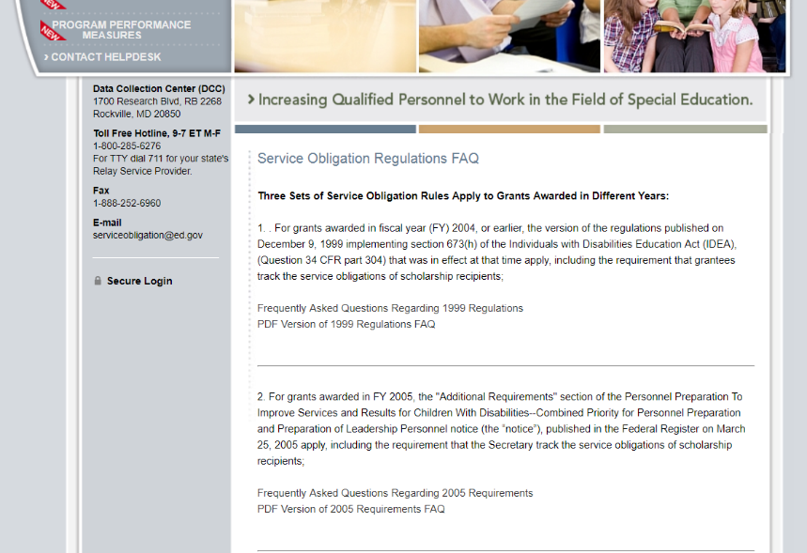
Support Using PDPDCS:
Website Resources
PDPDCS resources include:
  A closed-captioned recording of this webinar will be made available (https://pdp.ed.gov/OSEP/Home/Training).
  PDPDCS Frequently
  Asked Questions
  (https://pdp.ed.gov/
  OSEP/Home/dcsfaq).
Notes:
A recording of this webinar will be made available on the website for grantees and staff who missed this training or need a refresher. We will also send you an email from serviceobligation@ed.gov with a link to the recorded training as soon as it is available.
In addition, on the website you can find responses to questions frequently asked by grantees, scholars, and employers regarding program regulations and requirements pertaining to the grant funding, links to service obligation regulations and Pre-scholarship agreements and Exit Certifications. Our Help Desk is available M-F 8 am to 8pm EST via phone or email.

Slide 58
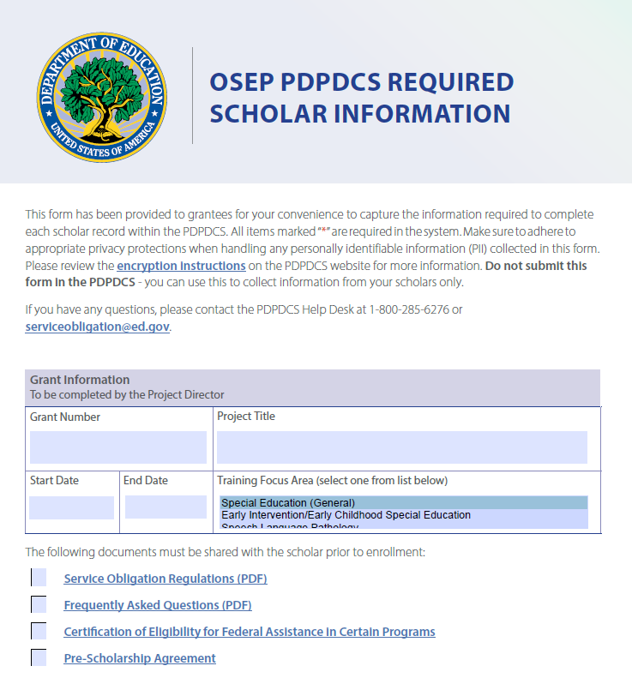
Required Scholar Information
Reference document to assist grantees with collecting information from scholars
Not to be submitted into PDPDCS
Adhere to privacy protections
Notes:
Grantees are encouraged to use the Required Scholar Information resource to help you gather the information needed to fill out the scholar record in the PDPDCS. This fillable PDF can be sent to scholars to have them enter their contact information, but we highly recommend adhering to privacy protections and using encryption when sending this document back and forth. Please DO NOT send this document to the Help Desk.
Once you have gathered the information from the scholar in this document, you can then use it to complete the scholar’s record in the PDPDCS and submit it.

Slide 59
Support Using PDPDCS:
Help Desk
The PDPDCS Help Desk is available by phone or email to answer questions you or your scholars may have regarding the PDPDCS. Help Desk support is available:
  Monday through Friday from 8 am to 8 pm, ET.
  Email: serviceobligation@ed.gov.
  Toll Free Hotline: 1-800-285-6276.
  If someone is not available when you call, please leave a message. A Help Desk operator will return your message within one business day.
A designated specialist can also spend additional time walking you through components of the PDPDCS. Just contact the Help Desk to set up an appointment.

